Slide 1
TRANSACTION MANAGEMENT

Slide 2
Transaction processing system :It is a system with large databases and hundreds of concurrent users that are executing database transactions.
Eg: Reservation, Banking, Stock markets
We can have
Single-User System: At most one user at a time can use the system.
Multi user System: Many users can access the system concurrently
Transaction: logical unit of database processing that includes one or more access operations (read -retrieval, write -insert or update, delete).

Slide 3
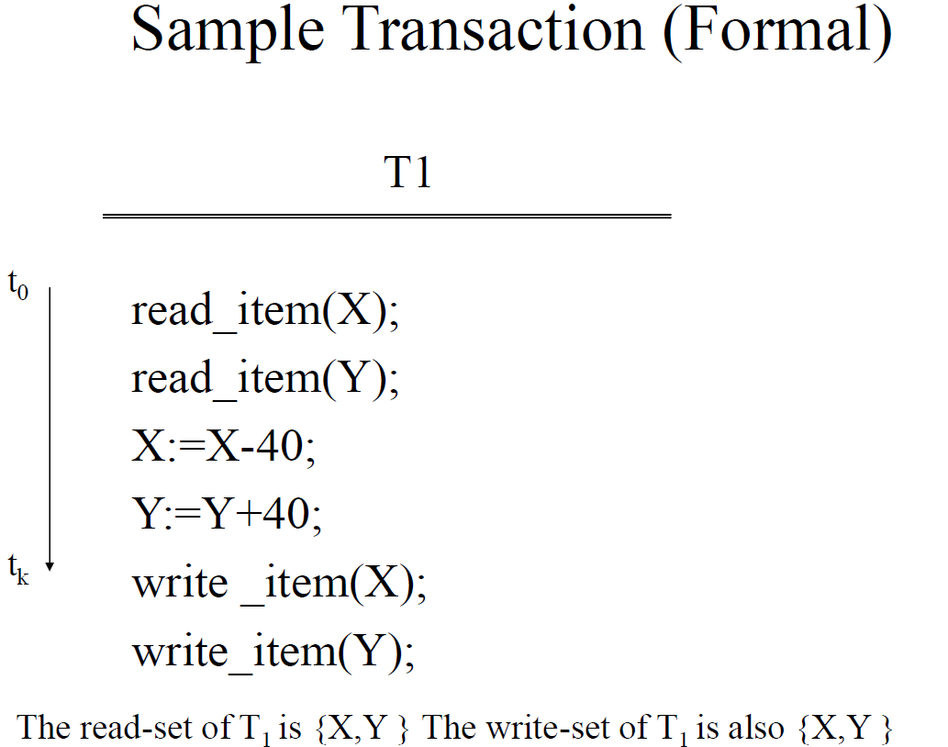
Sample Transaction (informal)
•Example: Move $40 from current to savings account
•To user, appears as one activity
•To database:
–Read balance of current account: read( X)
–Read balance of savings account: read (Y)
–Subtract $40 from X
–Add $40 to Y
–Write new value of X back to disk
–Write new value of Y back to disk

Slide 4
Why Do We Need Transactions?
• It’s all about fast query response time and correctness
• DBMS is a multi-user systems
–Many different requests
–Some against same data items

Slide 5
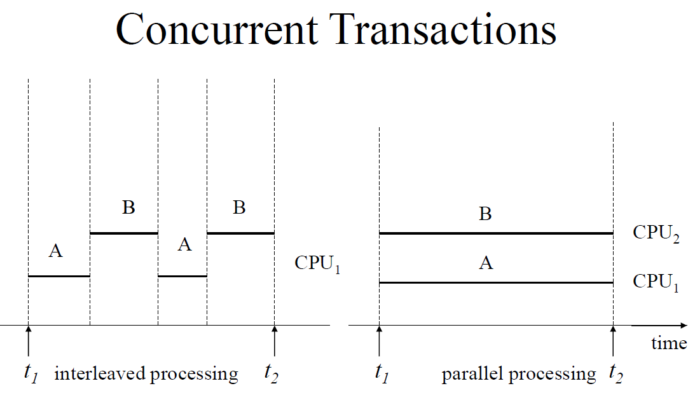
Interleaved processing:
• concurrent execution of processes is interleaved in a single CPU.
• In this example the process A and process B are executing concurrently in an interleaved fashion.
• Interleaving keeps CPU busy when a process requires an input or output(I/O) operation, such as reading a block from disk.
• The CPU is switched to execute another process rather than remaining idle during I/O time. Parallel processing: processes are concurrently executed in multiple CPUs.

Slide 6
Transactions, Read and Write Operations
Read only Transaction: If the database operations in a transaction do not update the database but only retrieve data, the transaction is called a read-only transaction.
Basic operations are read and write
read_item(X): Reads a database item named X into a program variable. To simplify our notation, we assume that the program variable is also named X.
write_item(X): Writes the value of program variable X into the database item named X.

Slide 7
READ AND WRITE OPERATIONS: Basic unit of data transfer from the disk to the computer main memory is one block. In general, a data item (what is read or written) will be the field of some record in the database, although it may be a larger unit such as a record or even a whole block.
read_item(X) command includes the following steps:
1. Find the address of the disk block that contains item X.
2. Copy that disk block into a buffer in main memory (if that disk block is not already in some main memory buffer).
3. Copy item X from the buffer to the program variable named X.
write_item(X) command includes the following steps:
Find the address of the disk block that contains item X.
Copy that disk block into a buffer in main memory(if that disk block is not already in some main memory buffer).
Copy item X from the program variable named X into its correct location in the buffer. 4. Store the updated block from the buffer back to disk (either immediately or at some later point in time)

Slide 8
WHY CONCURRENCY CONTROL IS NEEDED:
Several problems can occur when concurrent transactions execute without control

Slide 9
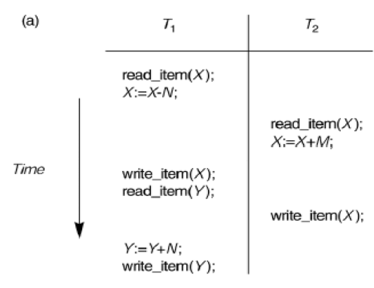
Consider the Air line reservations database in which a record is stored for each flight.
Each record includes the number of reserved seats for that flight as a named data item, among other information.
Transaction T1 shows that transfers N reservations from one flight whose no of reserved seats is stored in the data item named X to another flight whose no of reserved seats is stored in the data item named Y
Transaction T2 reserves M seats on the first flight (X) referenced in transaction T1.
Transaction T1 and T2 are specific executions of a program that refer to the specific flights whose no of seats are stored in data items X and Y in the database.

Slide 10
The following problems may encounter if the two transactions are run concurrently.
1.The Lost Update Problem
2.The Temporary Update (or Dirty Read) problem
3.The Incorrect Summary Problem
The Lost Update Problem This occurs when two transactions that access the same database items have their operations interleaved in a way that makes the value of some database item incorrect. Suppose the transaction T1 and T2 are submitted at the same time and suppose that their operations are interleaved then the final value of item X is incorrect because T2 reads the value of X before T1 changes it in the database and the updated value from T1 is lost.

Slide 11
For E.g. if X = 80 at the start (originally there were 80 reservations on the flight), N=5 (T1 transfers 5 seat reservations from the flight corresponding to X to the corresponding to Y) and M = 4 (T2 reserves 4 seats on X), the final result should be x=79 but in the interleaving of operations shown ,it is X=84 because the update in T1 that removed the five seats from X was lost.

Slide 12
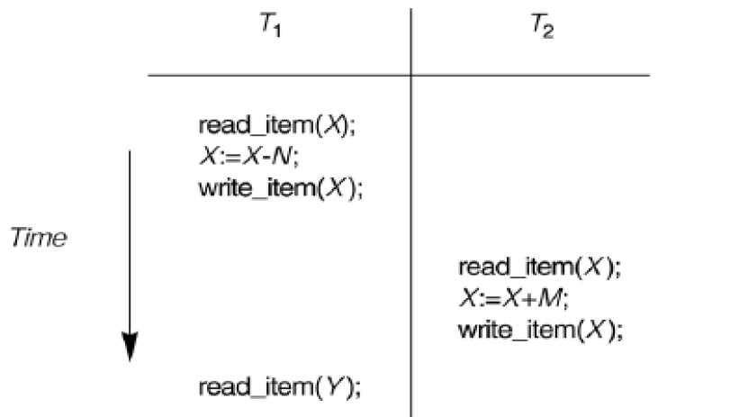
The Temporary Update (or Dirty Read) Problem. This occurs when one transaction updates a database item and then the transaction fails for some reason . The updated item is accessed by another transaction before it is changed back to its original value. In this e.g. Transaction T1 fails before completion, so the system must change X back to its original value . Before this the transaction T2 reads The temporary value of X which is not recorded permanently in the database because of the failure of T1.The value of item X that is read by T2 is called dirty data, because it has been created by a transaction that has not completed. Therefore this problem is known as dirty read problem.

Slide 13
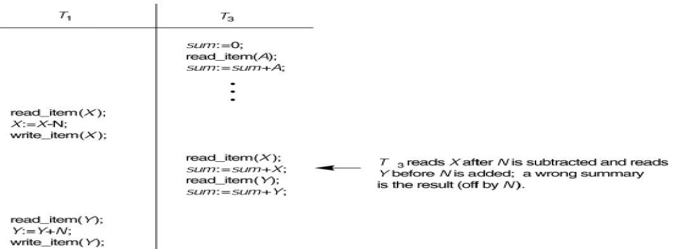
The Incorrect Summary Problem . If one transaction is calculating an aggregate summary function on a number of records while other transactions are updating some of these records, the aggregate function may calculate some values before they are updated and others after they are updated.
For example:
Transaction T3 is calculating the sum of all salaries in a table.
Meanwhile, Transaction T1 is updating some of the salaries in that table.
If T3 reads part of the table before the updates and another part after, the resulting sum will be inconsistent because it reflects data from two different points in time.

Slide 14
Why recovery is needed:
When we perform some transactions failures can occur.
Recovery refers to the process of restoring a database to a consistent state after a failure.
(consistent state refers to a state in which the database adheres to all predefined rules, constraints, and integrity conditions. In simpler terms, the data in the database must be valid, reliable, and follow all logical rules established by the database schema.)

Slide 15
Why recovery is needed: Continued
Different failures may occur which are generally classified as
– System crash
– Transaction or system error ( Some operation in the transaction may cause it to fail, such as integer overflow or division by zero. )
– Local errors ( For example, data for the transaction may not be found. A condition, such as insufficient account balance in a banking database, may cause a transaction, such as a fund withdrawal from that account, to be canceled.)
– Concurrency control enforcement
– Disk failure ( Some disk blocks may lose their data because of a read or write malfunction or because of a disk read/write head crash. )
– Physical failures (eg. Power failure)

Slide 16
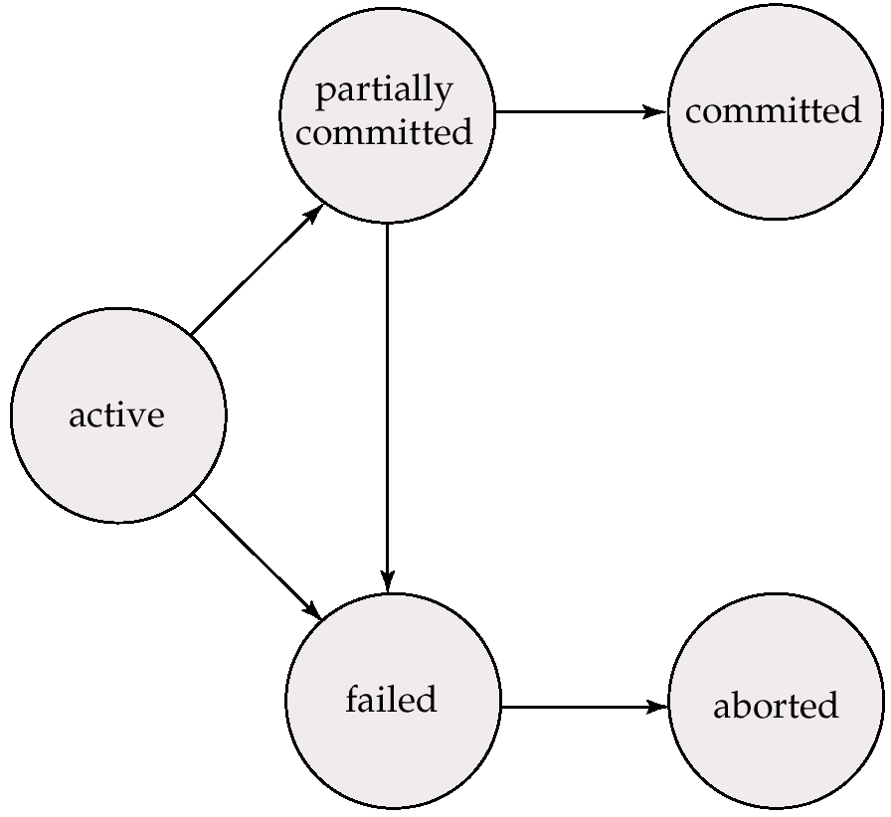
A transaction is an atomic unit of work that is either completed in its entirety or not done at all. For recovery purposes, the system needs to keep track of when the transaction starts, terminates, and commits or aborts.
Transaction states:
• Active state
• Partially committed state
• Committed state
• Failed state
• Aborted State

Slide 17
Active State:
This is the initial state of the transaction when the transaction starts its execution. At this point, it is actively working by reading or writing data. Any operations that the transaction performs occur in this state.
Partially Committed State:
When the final operation of a transaction is executed, it enters the partially committed state. The transaction has completed all its operations but may not yet be fully committed due to system checks (e.g., ensuring durability).
Committed State:
If the transaction completes successfully and all integrity constraints are satisfied, it enters the committed state. All changes made by the transaction are permanently saved to the database. Once in this state, the transaction cannot be undone.
Failed State:
If any error occurs during the transaction (e.g., integrity constraint violations, system failure, or deadlock), the transaction enters the failed state. The transaction cannot proceed, and any operations it performed may need to be undone.
Aborted State:
When a transaction fails, it moves from the failed state to the aborted state. In this state, any changes made by the transaction are rolled back (i.e., undone), and the system is restored to the state before the transaction began. The transaction can either be restarted or terminated.

Slide 18
How recovery can be done..
System Log
DBMS must assure that we don’t loose information due to system crashes
–i.e., how do we recover from failure?
Keep system log
–Kept on disk, backed up periodically
–Record every action

Slide 19
Log or Journal : The log keeps track of all transaction operations that affect the values of database items. This information may be needed to permit recovery from transaction failures. The log is kept on disk, so it is not affected by any type of failure except for disk failure.
In the following discussion refers to a unique transaction-id that is generated automatically by the system and is used to identify each transaction
Types of log record:
[start_transaction,T]: Records that transaction T has started execution.
[write_item,T,X,old_value,new_value]: Records that transaction T has changed the value of database item X from old_value to new_value.
[read_item,T,X]: Records that transaction T has read the value of database item X.
[commit,T]: Records that transaction T has completed successfully, and affirms that its effect can be committed (recorded permanently) to the database.
[abort,T]: Records that transaction T has been aborted

Slide 20
A transaction T reaches its commit point when all its operations that access the database have been executed successfully and the effect of all the transaction operations on the database has been recorded in the log. Beyond the commit point, the transaction is said to be committed, and its effect is assumed to be permanently recorded in the database.

Slide 21
To preserve integrity of data, the database system must ensure: Transactions have the ACID properties:
A = atomicity (a transaction should be done or undone completely ) -Task of the recovery subsystem to enforce atomicity
C = consistency (a transaction should transform a system from one consistent state to another consistent state) (consistent state refers to a state in which the database adheres to all predefined rules, constraints, and integrity conditions. In simpler terms, the data in the database must be valid, reliable, and follow all logical rules established by the database schema.)
–Users/DBMS: enforce implicit and explicit constraints.(Integrity )
I = isolation (each transaction should happen independently of other transactions )
D = durability (: Once a transaction changes the database and the changes are committed ,these changes must never be lost because of subsequent failure.)

Slide 22
SCHEDULES :
When transactions are executing concurrently in an interleaved fashion, the order of execution of operations from the various transactions is known as a schedule.
Transaction Schedule
• Only interested in read (r), write (w), commit (c), abort (a)
When studying schedules in databases, we focus primarily on read, write, commit, and abort operations because these are the core actions that directly impact concurrency control and the consistency of the database. These operations determine how transactions interact with each other and the database, and they help in analyzing the behavior of concurrent transactions.

Slide 23
In database systems, when analyzing schedules, we mainly focus on read, write, commit, and abort operations because they directly impact the consistency and correctness of concurrent transactions. Other operations, such as calculations, comparisons, or intermediate steps within a transaction, are often omitted in schedule analysis for the following reasons:
Concurrency Control: The goal of analyzing a schedule is to understand how transactions interact with each other when accessing shared data. Read and write operations are the ones that access and modify the database, potentially leading to conflicts like dirty reads, lost updates, and uncommitted data. These conflicts affect the serializability of transactions, which is central to ensuring correctness.
Effect on Data: Only read and write operations directly affect the data being processed. Operations such as arithmetic or logic inside a transaction don't alter the database state and are typically independent of other transactions. For example, computing a value before writing it to the database doesn't affect other transactions unless that value is written (a write operation).
Transaction Boundaries: The commit and abort operations define the boundaries of a transaction. A commit finalizes all changes made by the transaction, making them permanent, while an abort undoes all changes. These operations are essential for ensuring atomicity—one of the ACID properties (Atomicity, Consistency, Isolation, Durability). Without considering commit and abort, it's hard to assess the state of the database at any point in time.
Simplifying Analysis: By focusing on read, write, commit, and abort, the analysis of conflict serializability and view serializability becomes more straightforward. These operations are sufficient to identify whether a schedule is serializable (i.e., can be transformed into an equivalent serial schedule). Including other operations would complicate the analysis without providing additional useful information for determining correctness.

Slide 24
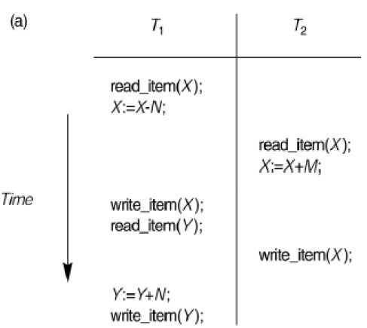
Ordering of execution of operations from various transactions
•T1: r(X); w(X); r(Y); w(Y); c1
•T2: r(X); w(X); c2
•Sample schedule: S: r1(X); r2(X); w1(X); r1(Y); w2(X); w1(Y); c1; c2

Slide 25
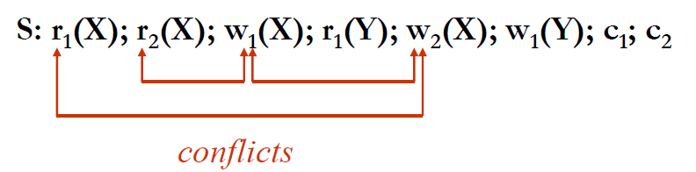
Two operations in a schedule are said to be conflict if they satisfy ALL three conditions:
1. They belong to different transactions
2. They access the same item X
3. At least one of the operations is a write_item(X).
In this r1(X); w2(X); are conflict likewise r2(X); w1(X); because r1 ,w2 are different transactions.
The operations r1(X) , r2(X) do not conflict since they are both read operations.
w2(X), w1(Y); do not conflict because they operate on distinct data items X and Y.
The operations r1(X) and w1(X) do not conflict because they belong to the same transaction.

Slide 26
A Schedule S of n transactions T1,T2…Tn is said to be complete schedule if the following conditions hold:
1.The operations in S are exactly those operations in T1,T2…Tn including a commit or abort operation as the last operation for each transaction in the schedule.
2.For any pair of operations from the same transaction Ti, their order of appearance in S is the same as their order of appearance in Ti
3.For any two conflicting operations, one of the two must occur before the other in the schedule.

Slide 27
Characterizing Schedules based on Recoverability
Recoverability ensures that transactions can be safely rolled back without causing inconsistencies in the database.
Why is Recoverability Important?
Preventing Inconsistencies: If a transaction commits after reading data from another transaction that later aborts, the committed transaction would have relied on invalid or incorrect data. This would lead to a consistency issue, as the results of the committed transaction would be based on uncommitted and incorrect changes.
Avoiding Cascading Rollbacks: In a schedule that is not recoverable, one transaction's failure can trigger a series of rollbacks (called cascading aborts), where multiple transactions that read from the failed transaction must also be aborted. This can lead to inefficiencies and further inconsistency.

Slide 28
Once a transaction T is committed, it should never be necessary to roll back T. The schedules that theoretically meet this criterion are called recoverable schedule.
A schedule S is recoverable if no transaction T in S Commits until all transactions T’ that have written an item that T reads have committed.
A transaction T reads from transaction T’ in a schedule S if some item X is first written by T’ and later read by T. In addition T’ should not have been aborted before T reads item X and there should be no transactions that write X after T’ writes it and before T reads it.
Sa :r1(X);w1(X);r2(X);r1(Y);w2(X);c2;a1; (What type it is recoverable or not)
Sb :r1(X);w1(X);r2(X);r1(Y);w2(X); w1(Y);c1;c2;
S :r1(X); r2(X); w1(X); r1(Y); w2(X); c2;w1(Y); c1;

Slide 29
Once a transaction T is committed, it should never be necessary to roll back T. The schedules that theoretically meet this criterion are called recoverable schedule.
A schedule S is recoverable if no transaction T in S Commits until all transactions T’ that have written an item that T reads have committed.
A transaction T reads from transaction T’ in a schedule S if some item X is first written by T’ and later read by T. In addition T’ should not have been aborted before T reads item X and there should be no transactions that write X after T’ writes it and before T reads it.
Sa : r1(X);w1(X);r2(X);r1(Y);w2(X);c2;a1; (not recoverable)
Sb : r1(X);w1(X);r2(X);r1(Y);w2(X); w1(Y);c1;c2; (recoverable)
S : r1(X); r2(X); w1(X); r1(Y); w2(X); c2;w1(Y); c1; (recoverable)
In regard with Sa: The problem occurs if T1 aborts after the c2 operation in Sa; then the value of X that T2 read is no longer valid and T2 must be aborted after it is committed, leading to a schedule that is not recoverable.

Slide 30
Cascade less schedule: In every transaction in the schedule reads only the items that are written by committed transactions.
Strict Schedules: A schedule in which a transaction can neither read or write an item X until the last transaction that wrote X has committed.

